Slide 1
Flappy Bird Game
Python, Py-game, and Super Fun!

Slide 2
Introduction
Briefly introduce the code.
Mention it's a Flappy Bird game implemented in Python using the Pygame library.
Highlight the importance of each section in creating the game.

Slide 3
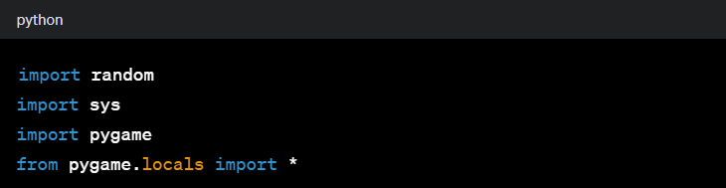
Imports:
random: Used for generating random numbers.
sys: Provides access to some variables used or maintained by the Python interpreter.
pygame: A cross-platform set of Python modules designed for writing video games.
pygame.locals: Contains constants like QUIT, KEYDOWN, etc., used by Pygame.

Slide 4
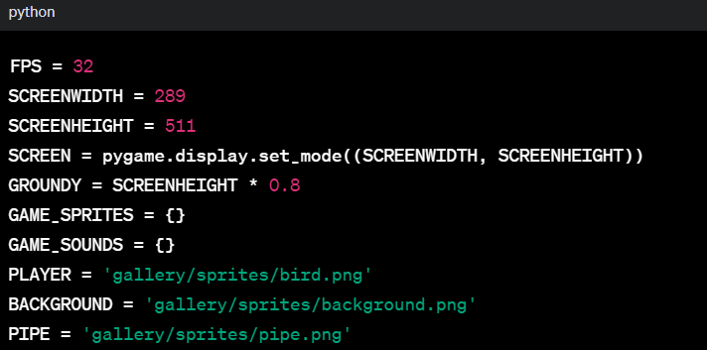
Global Variables:
FPS: Frames per second for the game.
SCREENWIDTH and SCREENHEIGHT: Dimensions of the game screen.
GROUNDY: Ground level position.
Paths to images (PLAYER, BACKGROUND, PIPE) used in the game.

Slide 5
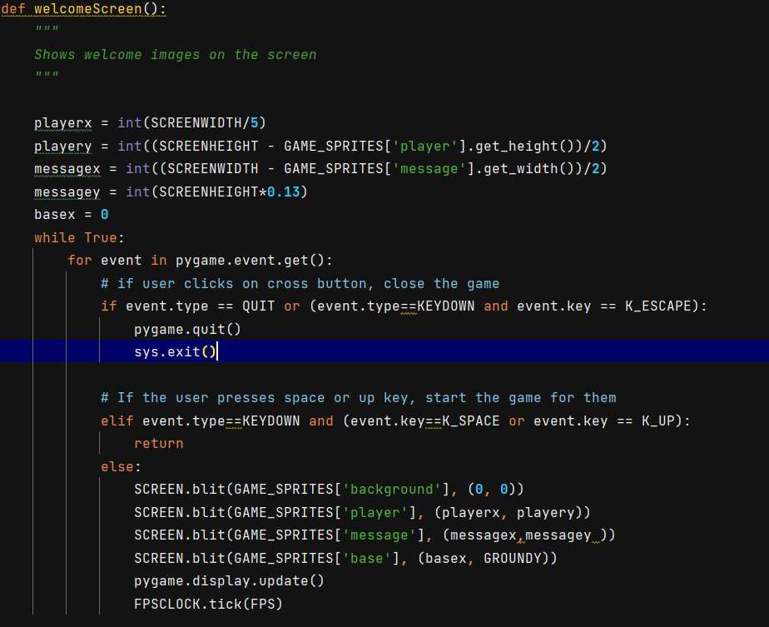
‘welcomescreen()’ Function
Displays welcome images on the screen.
Allows the user to start the game by pressing the spacebar or the up arrow key.
Uses Pygame event handling to manage user input.

Slide 6

‘maingame()’ Function
Implements the main game loop.
Handles user input for jumping the bliting pipes.
Manages the movement of pipes, scoring, and collision detection.
6

Slide 7

‘isCollide()’ Function
Checks for collisions between the player and pipes or ground.
Plays a 'hit' sound effect if a collision is detected.

Slide 8

‘getrandomPipe()’ Function

